Slide 1

[SCHOOL NAME]
[Date]
COORDINATOR:
[Coordinator Name]

Slide 2



• Cereal
• Snacks
• Meals & sides
• Baking products
• Pet treats
• And more!

Slide 3


You can submit your digital receipt through the Box Tops app and earn for our school, too!
Earn for schools with the brands you love.
Use the Box Tops app to submit your receipt within 14 days of purchase.
Box Tops products are identified and earnings are credited online.

Slide 4


Twice a year, our school will receive a Box Tops earnings check – once in December and again in April.
CLASSROOM
TECHNOLOGY
ART
SUPPLIES
LIBRARY BOOKS

Slide 5
DOWNLOAD the Box Tops app and select our school to support.
This ensures that your Box Tops purchases count toward our school's earnings.
SHOP for Box Tops products and use the app to scan your receipt to add to our school’s earnings online.
SPREAD THE WORD about Box Tops!
Invite friends to support our school with Box Tops using the "Invite Friends" feature in the app.
You'll BOTH earn Bonus Box Tops for our school when they scan their first receipt!

Slide 6

LAST YEAR’S EARNINGS:
$[TOTAL HERE]
THIS YEAR’S GOAL:
$[GOAL HERE]
WE’RE HOPING TO USE OUR BOX TOPS CASH TO FUND:
[Enter items here]

Slide 7
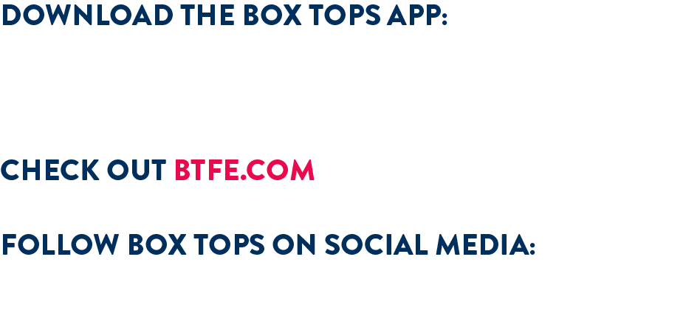

for more information
@boxtopsforeducation
@btfe

